Slide 4
1) Foster
a race
mentality

Slide 5
2) Forget
the past

Slide 6
3) Fix your
eyes on
the prize

Slide 7
4) Follow
good role
models

Slide 8
5) FOCUS!

Slide 9
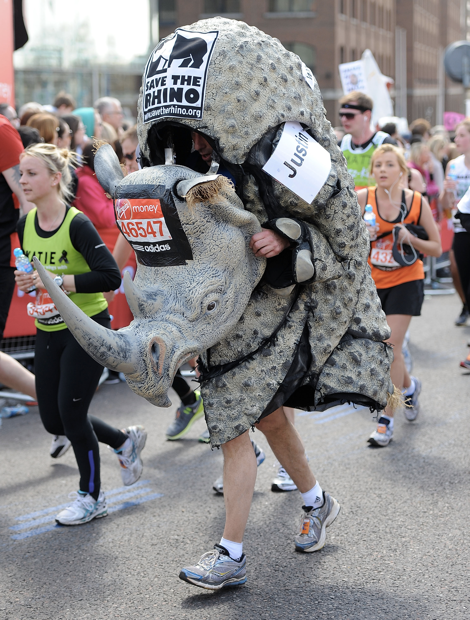

Slide 10
5) FOCUS!

Slide 11
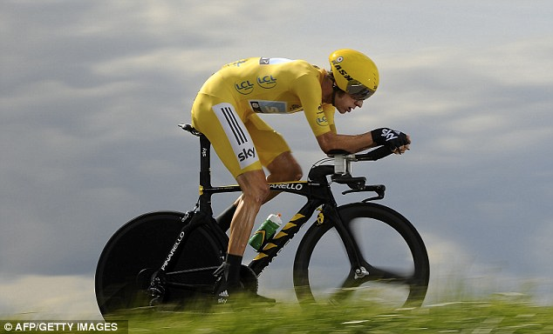

Slide 12
1) Foster
a race
mentality

Slide 13
2) Forget
the past

Slide 14
3) Fix your
eyes on
the prize

Slide 15
4) Follow
good role
models

Slide 16
5) FOCUS!

